Slide 2
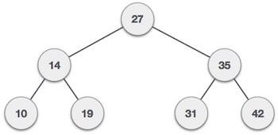
Binary Search Tree
40
A binary search tree (BST) is a tree in which all nodes follows the below mentioned properties −
The left sub-tree of a node has data less than to its parent node's data.
The right sub-tree of a node has data greater than to its parent node's data.
Thus, a BST divides all its sub-trees into two segments; left sub-tree and right sub-tree and can be defined as - left_subtree (data) < node (data) < right_subtree (data)
Example
Quick Questions?
Question - Where is the smallest & largest element in binary search tree resides?
Answer - Leftmost & Rightmost Positions

Slide 3
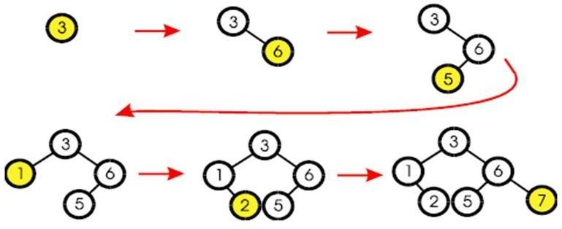
BST- Insertion
41

Slide 4
BST- Insertion Algorithm
42
if tree is empty
create a root node with the new key
else
compare key with the top node if key = node key
Duplicate value
else if key > node key
compare key with the right subtree:
if subtree is empty create a leaf node else add key in right subtree
else key < node key
compare key with the left subtree:
if the subtree is empty create a leaf node else add key to the left subtree

Slide 5
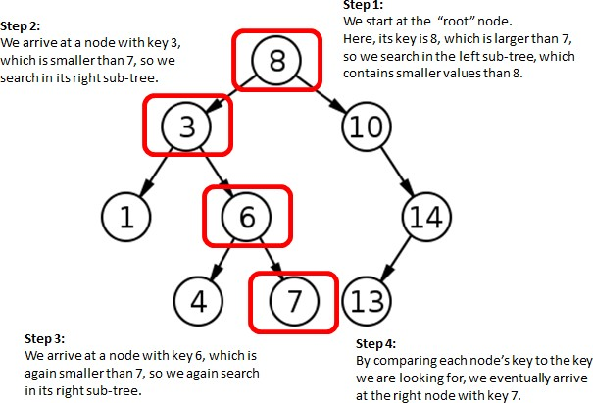
BST- Search
43
Node with key value 7 to be searched

Slide 6
BST– Search Algorithm
44
if the tree is empty
return NULL
else if the key value in the node(root) equals the target return the node value
else if the key value in the node is greater than the target return the result of searching the left subtree
else if the key value in the node is smaller than the target return the result of searching the right subtree

Slide 7
BST– Search - C Function
45
/* return a pointer to the node that contains key. If there is no such node, return NULL */ node* search(node * root, int key)
{
if (!root)
{
return NULL;
}
if (key == root->key)
{
return root;
}
if (key < root->key)
{
return search(root->left, key);
}
return search(root->right, key);
}

Slide 8
BST – Search Minimum and Maximum Key C Function
46
Minimum Key
Maximum Key
node* searchMinimum(node * root)
{
if (root==Null)
{
return NULL;
}
while (root -> left != NULL)
{
root = root -> left;
}
return root;
}
node* searchMaximum(node * root)
{
if (root==Null)
{
return NULL;
}
while (root -> right != NULL)
{
root = root -> right;
}
return root;
}

Slide 9
BST - Deletion
47
Removing a node from a BST is a bit more complex, since any “holes” should not be created in the
tree. The intention is to remove the specified item from the BST and adjusts the tree.
The binary search algorithm is used to locate the target item: starting at the root, it probes down the tree till it finds the target or reaches a leaf node.
Experimenting the cases
if the tree is empty return false
else attempt to locate the node containing the target using the binary search algorithm:
if the target is not found return false
else the target is found, then remove its node & return true. Now while
removing the node four cases may happen
Case 1 - if the node has 2 empty subtrees
Case 2 - if the node has a left and a right subtree
Case 3 - if the node has no left child
Case 4 - if the node has no right child

Slide 10
























BST – Deletion – Case 1
48
Case 1: removing a node with 2 empty subtrees
Action: replace the link in the parent with null and delete the node
Removing 4
Parent
7 7
5 9
5
9
Z
4
6
8
10
6 8
10
Z points to the node which is to be deleted from the tree

Slide 11


































BST – Deletion – Case 2
49
Case 2: removing a node with 2 subtrees
Action: - replace the node's value with the max value in the left subtree and delete the max node in the left subtree
Removing 7
Z
7
6
5
9
5
9
4
6
8
10
4 8
10
Z points to the node which is to be deleted from the tree

Slide 12































BST – Deletion – Case 3
50
Case 3: if the node has no left child
Action: link the parent of the node to the right node of non- empty subtree and delete the node
Removing 5
Parent
Parent
Z
7
7
5
9
9
6
6
8
10
8
10
Z points to the node which is to be deleted from the tree

Slide 13































BST – Deletion – Case 4
51
Case 4: if the node has no right child
Action: link the parent of the node to the left node of non- empty subtree and delete the node
Removing 5
Parent
Parent
Z
7
7
5
9
9
4
4
8
10
8
10
Z points to the node which is to be deleted from the tree

Slide 14
BST Deletion Pseudo code
52
void delete(node *root, key)
{
IF (root == NULL) THEN
exit
END IF
void deleteNode(node *root)
{
IF (root->left == NULL AND root->right == NULL) //Case - 1
free(root) [free is the C function to release the memory allotted to the node] exit
ENDIF
IF (root->data>key) THEN delete(root->left, key)
ELSE IF (root->data<key) THEN
delete(root->right, key)
ELSE
deletenode(root) ENDIF
IF (root->left != NULL) THEN //Case – 4 and Case - 2
struct node *temp=root->left;
WHILE(temp->right!=NULL) temp=temp->right;
ENDWHILE
root->data=temp->data; free(temp)
ELSE //Case 3
struct node *temp = root->right; WHILE(temp->left != NULL) temp=temp->left;
ENDWHILE
root->data = temp->data; free(temp);
ENDIF
}
}

